Slide 1

Machine Learning (Basic Concepts Part B)

Slide 2
Topics to be covered:
Overfitting and Underfitting
Good Model Vs Bad Model
Performance Evaluation
Evaluation Metrics
Performance Evaluation (Regression)

Slide 3
Overfitting and Underfitting

Slide 4
Machine Learning
Overfitting
The model fits too much to the noise from the data.
This often results in low error on training sets but high error on test/validation sets.

Slide 5
Machine Learning
Data
Y
X

Slide 6
Machine Learning
Good Model
Y
X

Slide 7
Machine Learning
Overfitting
Y
X

Slide 8
Machine Learning
Overfitting
Y
X

Slide 9
Machine Learning
Overfitting
Y
X

Slide 10
Machine Learning
Overfitting
Y
X

Slide 11
Techniques to reduce overfitting: 1. Increase training data. 2. Reduce model complexity. 3. Early stopping during the training phase (have an eye over the loss over the training period as soon as loss begins to increase stop training). 4. Ridge Regularization and Lasso Regularization 5. Use dropout for neural networks to tackle overfitting.

Slide 12
Machine Learning
Underfitting
Model does not capture the underlying trend of the data and does not fit the data well enough.
Low variance but high bias.
Underfitting is often a result of an excessively simple model.

Slide 13
Machine Learning
Data
Y
X

Slide 14
Machine Learning
Underfitting
Y
X

Slide 15
Techniques to reduce underfitting: 1. Increase model complexity 2. Increase the number of features, performing feature engineering 3. Remove noise from the data. 4. Increase the number of epochs or increase the duration of training to get better results.

Slide 16
Underfitting and Overfitting
https://towardsdatascience.com/what-are-overfitting-and-underfitting-in-machine-learning-a96b30864690
https://www.geeksforgeeks.org/underfitting-and-overfitting-in-machine-learning/ → in terms of bias and variance

Slide 17
Machine Learning
This data was easy to visualize, but how can we see underfitting and overfitting when dealing with multi dimensional data sets?
First let’s imagine we trained a model and then measured its error over training time.

Slide 18
Machine Learning
Good Model
Error
Training Time

Slide 19
Machine Learning
Good Model
Error
Epochs

Slide 20
Machine Learning
Bad Model
Error
Epochs

Slide 21
Machine Learning
When thinking about overfitting and underfitting we want to keep in mind the relationship of model performance on the training set versus the test/validation set.

Slide 22
Machine Learning
Let’s imagine we split our data into a training set and a test set

Slide 23
Machine Learning
We first see performance on the training set
Error
Epochs

Slide 24
Machine Learning
Next we check performance on the test set
Error
Epochs

Slide 25
Machine Learning
Ideally the model would perform well on both, with similar behavior.
Error
Epochs

Slide 26
Machine Learning
But what happens if we overfit on the training data? That means we would perform poorly on new test data!
Error
Epochs

Slide 27
Machine Learning
But what happens if we overfit on the training data? That means we would perform poorly on new test data!
Error
Epochs

Slide 28
Machine Learning
This is a good indication of training too much on the training data, you should look for the point to cut off training time!
Error
Epochs

Slide 29
Machine Learning
We’ll check on this idea again when we actually begin creating models!
For now just be aware of this possible issue!

Slide 30
Evaluating Performance
CLASSIFICATION

Slide 31
Model Evaluation
We just learned that after our machine learning process is complete, we will use performance metrics to evaluate how our model did.
Let’s discuss classification metrics in more detail!

Slide 32
Model Evaluation
The key classification metrics we need to understand are:
Accuracy
Recall
Precision
F1-Score

Slide 33
Model Evaluation
But first, we should understand the reasoning behind these metrics and how they will actually work in the real world!

Slide 34
Model Evaluation
Typically in any classification task your model can only achieve two results:
Either your model was correct in its prediction.
Or your model was incorrect in its prediction.

Slide 35
Model Evaluation
Fortunately incorrect vs correct expands to situations where you have multiple classes.
For the purposes of explaining the metrics, let’s imagine a binary classification situation, where we only have two available classes.

Slide 36
Model Evaluation
In our example, we will attempt to predict if an image is a dog or a cat.
Since this is supervised learning, we will first fit/train a model on training data, then test the model on testing data.
Once we have the model’s predictions from the X_test data, we compare it to the true y values (the correct labels).

Slide 37
Model Evaluation
TRAINED
MODEL

Slide 38

Model Evaluation
TRAINED
MODEL
Test Image
from X_test

Slide 39
Model Evaluation
TRAINED
MODEL
Test Image
from X_test
DOG
Correct Label
from y_test

Slide 40
Model Evaluation
TRAINED
MODEL
Test Image
from X_test
DOG
Prediction on
Test Image
DOG
Correct Label
from y_test

Slide 41
Model Evaluation
TRAINED
MODEL
Test Image
from X_test
DOG
Prediction on
Test Image
DOG
Correct Label
from y_test
DOG == DOG ?
Compare Prediction to Correct Label

Slide 42
Model Evaluation
TRAINED
MODEL
Test Image
from X_test
CAT
Prediction on
Test Image
DOG
Correct Label
from y_test
DOG == CAT ?
Compare Prediction to Correct Label

Slide 43
Model Evaluation
We repeat this process for all the images in our X test data.
At the end we will have a count of correct matches and a count of incorrect matches.
The key realization we need to make, is that in the real world, not all incorrect or correct matches hold equal value!

Slide 44
Model Evaluation
Also in the real world, a single metric won’t tell the complete story!
We can organize our predicted values compared to the real values in a confusion matrix.

Slide 45
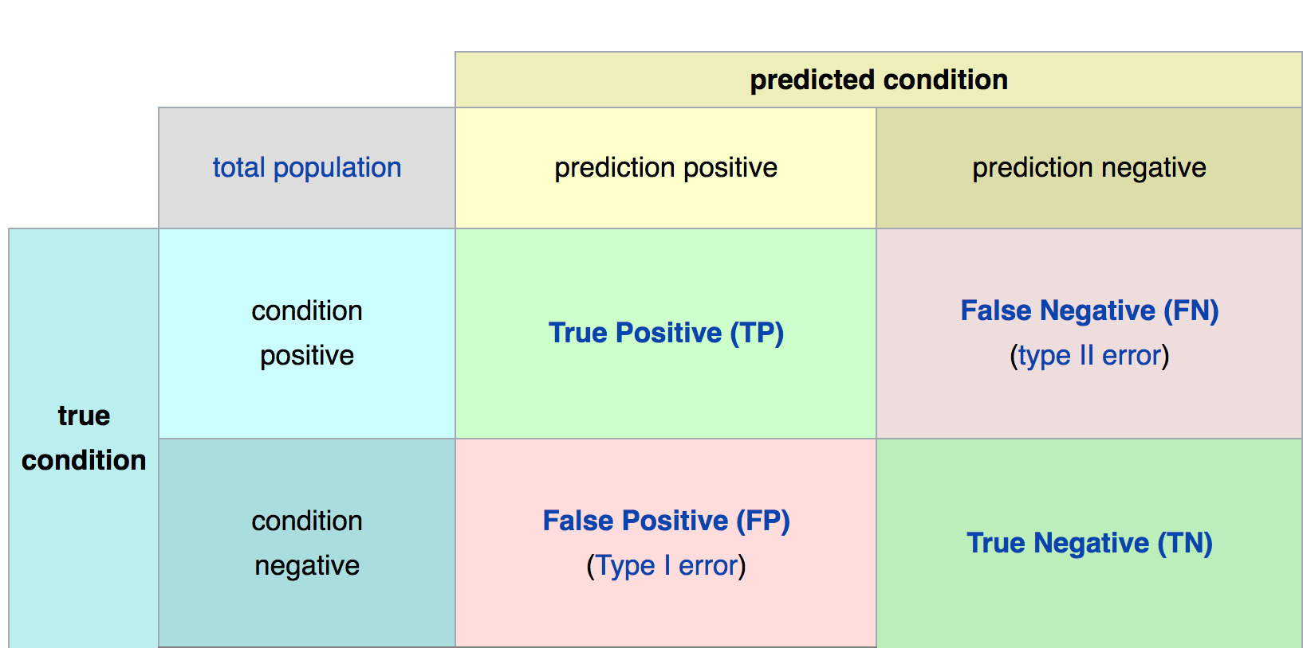
Confusion Matrix
Math &
Statistics
Machine Learning
DS
Software
Research
Domain
Knowledge

Slide 46
Model Evaluation
Accuracy
Accuracy in classification problems is the number of correct predictions made by the model divided by the total number of predictions.

Slide 47
Model Evaluation
Accuracy
For example, if the X_test set was 100 images and our model correctly predicted 80 images, then we have 80/100.
0.8 or 80% accuracy.

Slide 48
Model Evaluation
Accuracy
Accuracy is useful when target classes are well balanced
In our example, we would have roughly the same amount of cat images as we have dog images.

Slide 49
Model Evaluation
Accuracy
Accuracy is not a good choice with unbalanced classes!
Imagine we had 99 images of dogs and 1 image of a cat.
If our model was simply a line that always predicted dog we would get 99% accuracy!

Slide 50
Model Evaluation
Accuracy
Imagine we had 99 images of dogs and 1 image of a cat.
If our model was simply a line that always predicted dog we would get 99% accuracy!
In this situation we’ll want to understand recall and precision

Slide 51
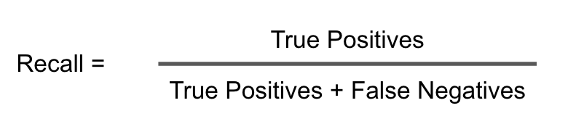
Model Evaluation
Recall
Ability of a model to find all the relevant cases within a dataset.

Slide 52
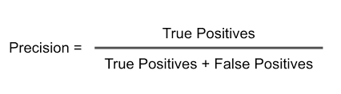
Model Evaluation
Precision
Ability of a classification model to identify only the relevant data points.

Slide 53
Model Evaluation
Recall and Precision
Often you have a trade-off between Recall and Precision.
While recall expresses the ability to find all relevant instances in a dataset, precision expresses the proportion of the data points our model says was relevant actually were relevant.

Slide 54
Model Evaluation
F1-Score
In cases where we want to find an optimal blend of precision and recall we can combine the two metrics using what is called the F1 score.

Slide 55
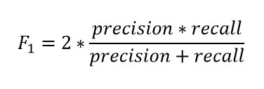
Model Evaluation
F1-Score
The F1 score is the harmonic mean of precision and recall taking both metrics into account in the following equation:

Slide 56
Model Evaluation
F1-Score
We use the harmonic mean instead of a simple average because it punishes extreme values.
A classifier with a precision of 1.0 and a recall of 0.0 has a simple average of 0.5 but an F1 score of 0.

Slide 57
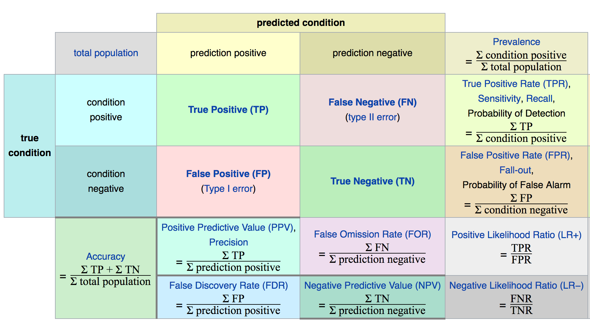
Confusion Matrix
Math &
Statistics
Machine Learning
DS
Software
Research
Domain
Knowledge

Slide 58
Model Evaluation
The main point to remember with the confusion matrix and the various calculated metrics is that they are all fundamentally ways of comparing the predicted values versus the true values.
What constitutes “good” metrics, will really depend on the specific situation!

Slide 59
Model Evaluation
Let’s think back on this idea of:
What is a good enough accuracy?
This all depends on the context of the situation!
Did you create a model to predict presence of a disease?
Is the disease presence well balanced in the general population? (Probably not!)

Slide 60
Model Evaluation
Often models are used as quick diagnostic tests to have before having a more invasive test (e.g. getting urine test before getting a biopsy)
We also need to consider what is at stake!

Slide 61
Model Evaluation
Often we have a precision/recall trade off, We need to decide if the model will should focus on fixing False Positives vs. False Negatives.
In disease diagnosis, it is probably better to go in the direction of False positives, so we make sure we correctly classify as many cases of disease as possible!

Slide 62
Model Evaluation
All of this is to say, machine learning is not performed in a “vacuum”, but instead a collaborative process where we should consult with experts in the domain
(e.g. medical doctors)

Slide 63
Evaluating Performance
REGRESSION

Slide 64
Evaluating Regression
Regression is a task when a model attempts to predict continuous values (unlike categorical values, which is classification)

Slide 65
Evaluating Regression
For example, attempting to predict the price of a house given its features is a regression task.
Attempting to predict the country a house is in given its features would be a classification task.

Slide 66
Evaluating Regression
You may have heard of some evaluation metrics like accuracy or recall.
These sort of metrics aren’t useful for regression problems, we need metrics designed for continuous values!

Slide 67
Evaluating Regression
Let’s discuss some of the most common evaluation metrics for regression:
Mean Absolute Error
Mean Squared Error
Root Mean Square Error

Slide 68
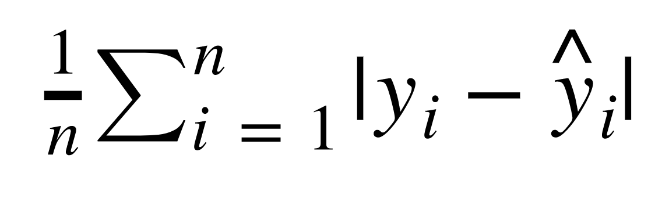
Evaluating Regression
Mean Absolute Error (MAE)
This is the mean of the absolute value of errors.
Easy to understand

Slide 69
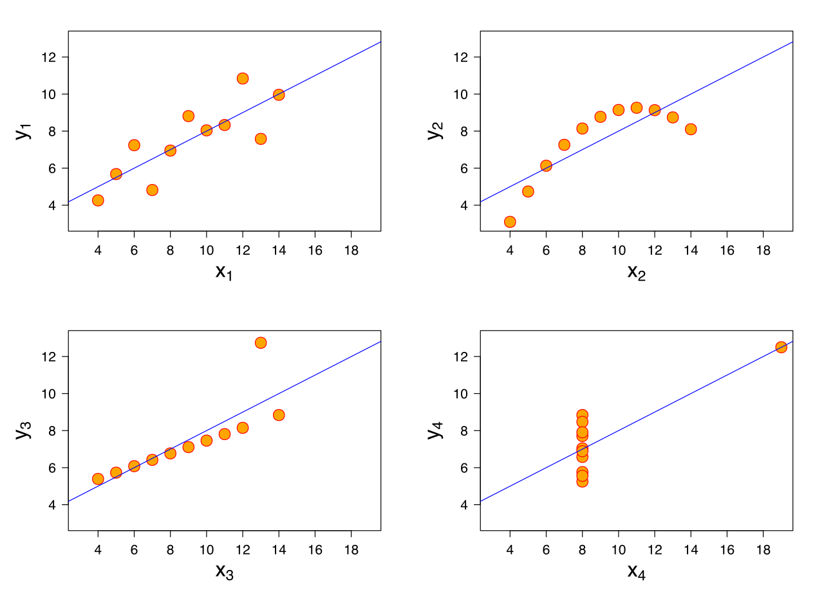
Evaluating Regression
MAE won’t punish large errors however.

Slide 70
Evaluating Regression
MAE won’t punish large errors however.

Slide 71
Evaluating Regression
We want our error metrics to account for these!

Slide 72
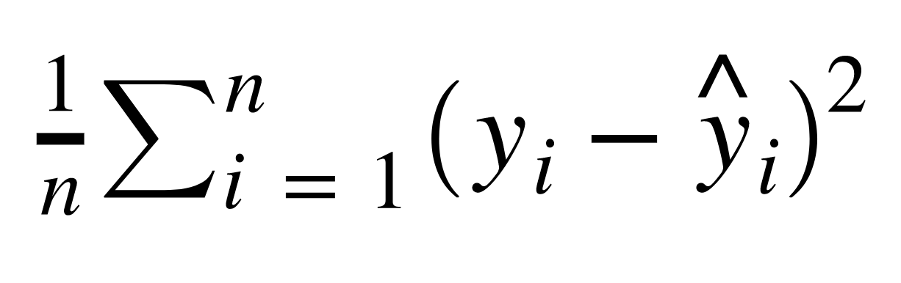
Evaluating Regression
Mean Squared Error (MSE)
This is the mean of the squared errors.
Larger errors are noted more than with MAE, making MSE more popular.

Slide 73
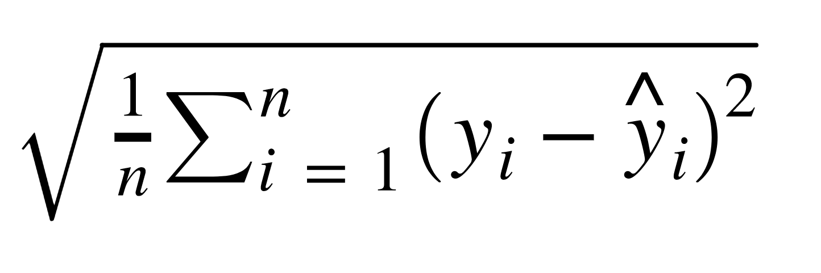
Evaluating Regression
Root Mean Square Error (RMSE)
This is the root of the mean of the squared errors.
Most popular (has same units as y)

Slide 74
Machine Learning
Most common question from students:
“Is this value of RMSE good?”
Context is everything!
A RMSE of $10 is fantastic for predicting the price of a house, but horrible for predicting the price of a candy bar!

Slide 75
Machine Learning
Compare your error metric to the average value of the label in your data set to try to get an intuition of its overall performance.
Domain knowledge also plays an important role here!

Slide 76
Machine Learning
Context of importance is also necessary to consider.
We may create a model to predict how much medication to give, in which case small fluctuations in RMSE may actually be very significant.

